Slide 1



Thesis Proposal Defense
Design of an Integrated Modular Motor Drive (IMMD) for Traction Applications
Mesut Uğur
Department of Electrical and Electronics Engineering
Middle East Technical University
xx.05.2018
Supervisor: Asst. Prof. Dr. Ozan Keysan

Slide 2
Outline
Motivation: 2
Literature survey: 3
Projects: 1
Research work: 3
Prototype design: 2
Future work: 2

Slide 3
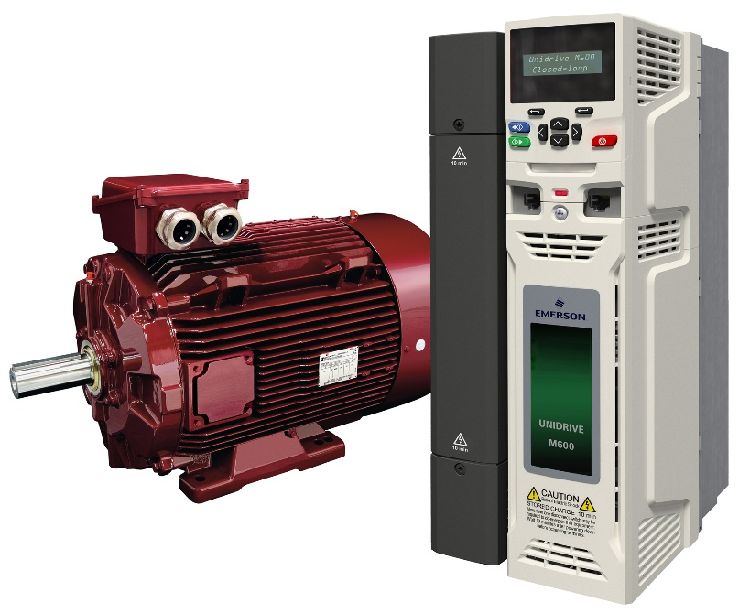
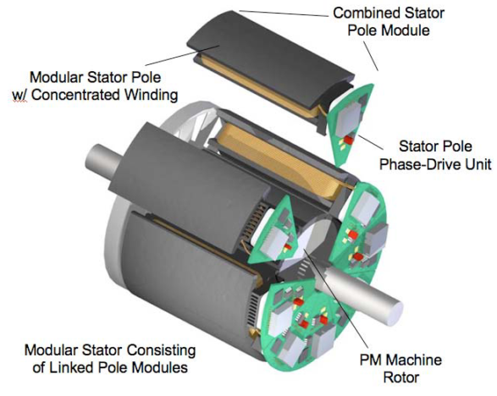
What is IMMD?
Drives are placed in a separate cabinet
Increased volume, weight and cost
Connection with long cables
Long cable effect, EMI problems
The motor drive is integrated to the motor
Both the motor and the drive are modularized
Increased power density
Reduced cost
Reduced EMI
Fault tolerance
Redundancy
Reduced stress

Slide 4
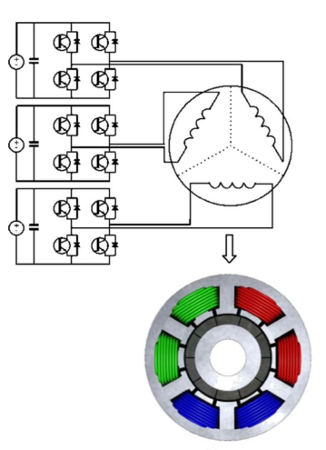
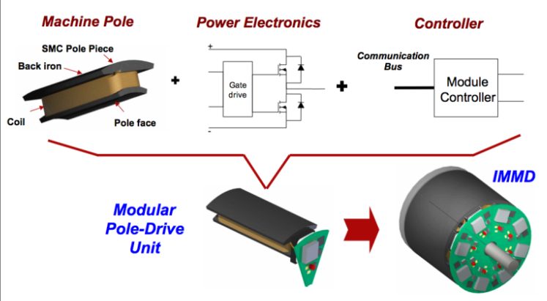
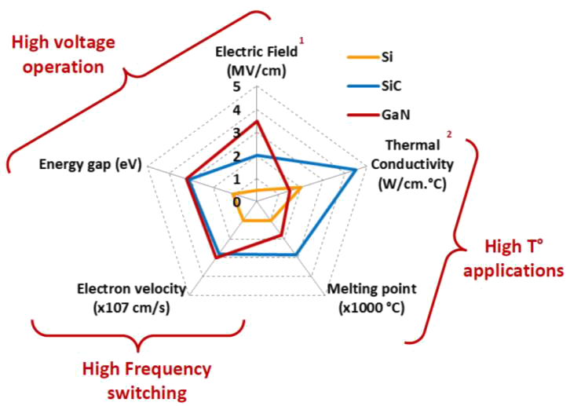

What is IMMD?
Integrated Modular Motor Drive
Challenges:
Size reduction
Thermal management
Vibration

Slide 5


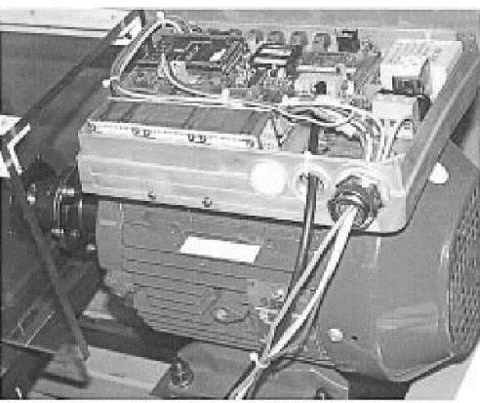
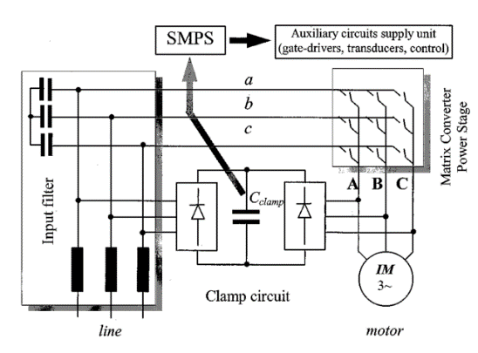
State of the Art
2002, Matrix Converter Motor (MCM) for Industry Applications
Christian Klumpner, Peter Nielsen, Ion Boldea, Frede Blaabjerg, Paul Thargersen
First integrated regenerative frequency converter motor for industry applications
Based on a matrix converter topology
4-kW matrix converter motor prototype
No modularization
IGBT-diode

Slide 6

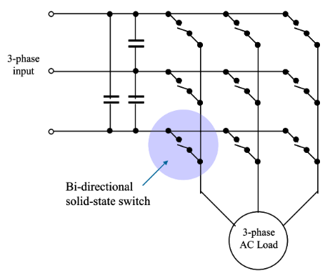
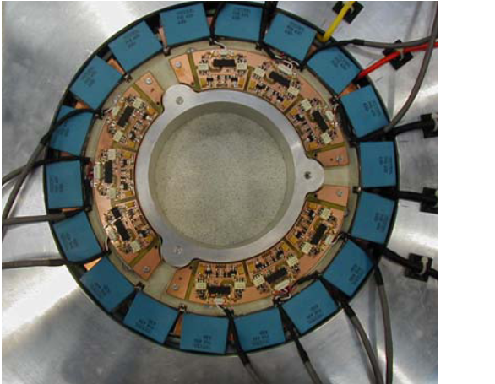
State of the Art
2005, A Fully Integrated 30kW Motor Drive Using Matrix Converter Technology
P W Wheeler, J C Clare, L Empringham, Bradley, S Pickering, D Lampard, K J, M Apap
Targeted at pump and fan applications with induction motor
Fully tested and evaluated demonstrations of the power converter and the cooling arrangements
30 kW prototype, power electronics housed in a re-designed End Plate
IGBT based, 415 Volt, 50 Hz supply.

Slide 7

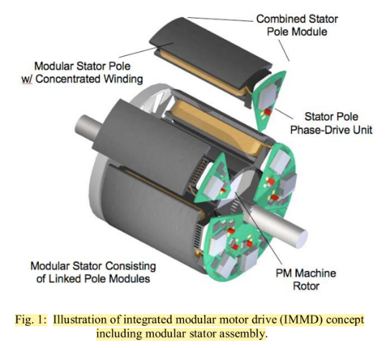
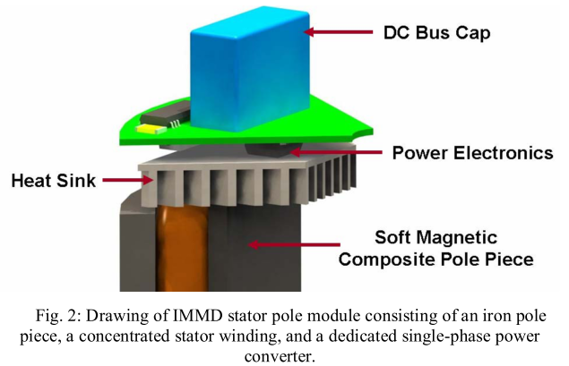
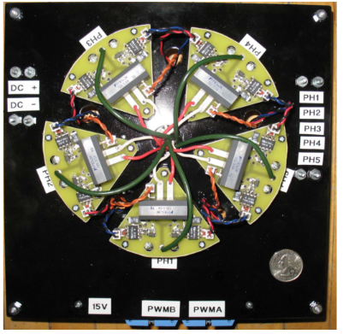
State of the Art
2007, Power Converter Design for an Integrated Modular Motor Drive
N.R. Brown, T.M. Jahns, R.D. Lorenz
Five-phase machine, soft magnetic composite (SMC) material, six-pole PM rotor
2.7 kW output power
IGBTs and anti-parallel diodes, 10kHz
Hard-switched half-bridge inverter
Experimental results with RL load

Slide 8

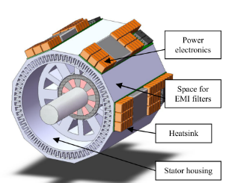
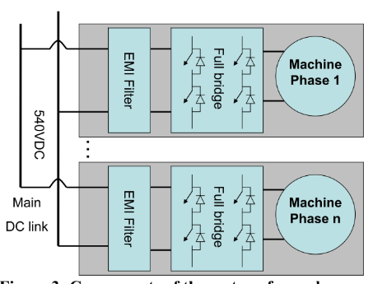
State of the Art
2008, A 50kW Integrated Fault Tolerant Permanent Magnet Machine and Motor Drive
J.J. Wolmarans, M.B. Gerber, H. Polinder, S.W.H. de Haan, J.A. Ferreira, D. Clarenbach
An overall goal of 2kW/kg is set for system power density
A 50kW, 6 phase, 8 pole permanent magnet machine with a speed of 50krpm
+/-270VDC bus, as utilized in current and future new aircraft
“No single electrical fault may cause the system as a whole to stop functioning”
Simulation results

Slide 9

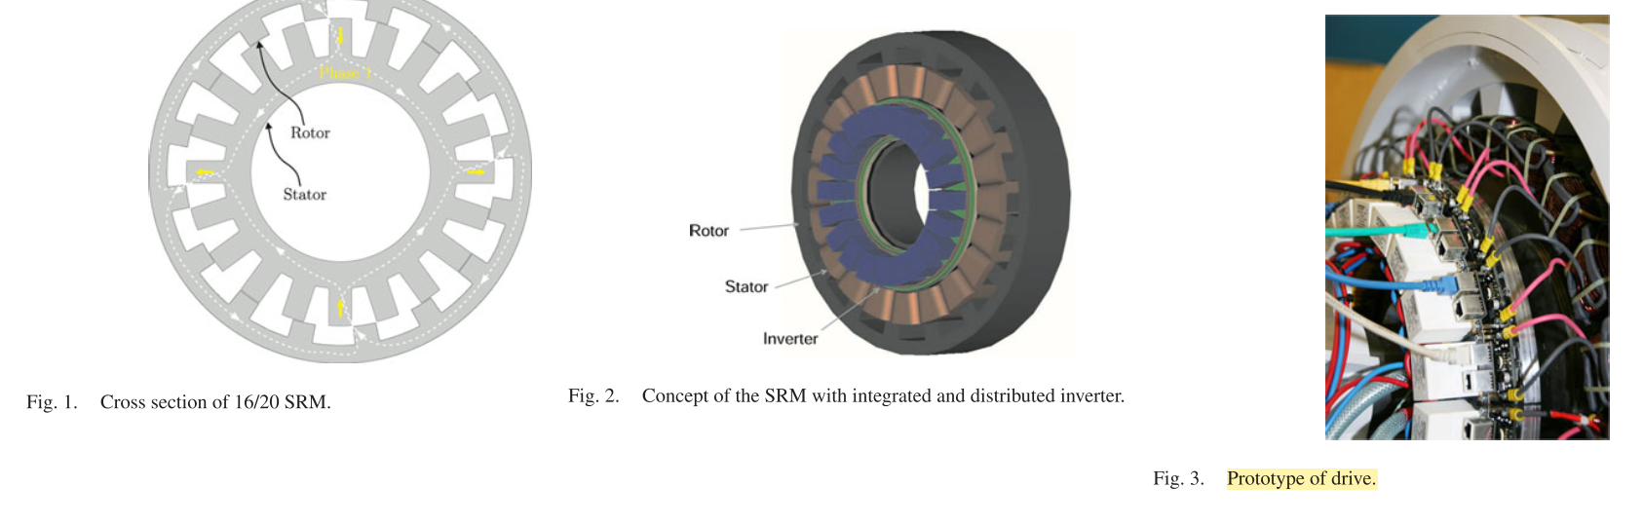
State of the Art
2012, Development and Control of an Integrated and Distributed Inverter for a Fault Tolerant Five-Phase Switched Reluctance Traction Drive
Martin D. Hennen, Markus Niessen, Christian Heyers, Helge J. Brauer, RikW. De Doncker
Five phase, outer-rotor direct drive, 67kW, 750rpm, 20/16
Railway traction applications, 400V DC link, 30A current, 3.4kW, 10kHz
Generation of the switching signals is realized on a CPLD on each pole module
The predictive PWM-based direct instantaneous torque control (PWM-DITC)
Fault tolerance analysis: torque ripple, unbalanced magnetic pull, vibration shapes

Slide 10
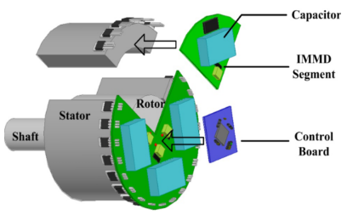
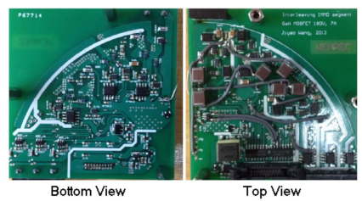
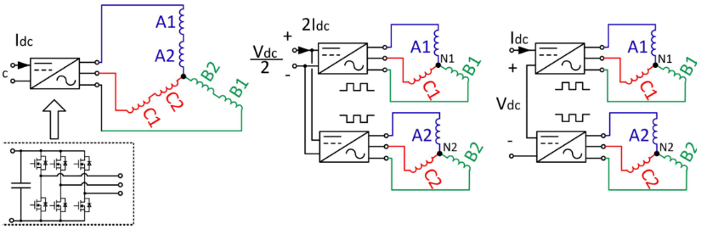
State of the Art
2013, Evaluation and Design for an Integrated Modular Motor Drive (IMMD) with GaN devices
Jiyao Wang, Ye Li, Yehui Han
Series-connected inverter segments
Wide bandgap 200V GaN MOSFETs
Eliminating inverter heat sink
Keep the height of capacitors within 1 inch, active DC link balancing
Experiment: 180Vdc, 7Arms, 0.6inch height, 3inch radius, RL load

Slide 11

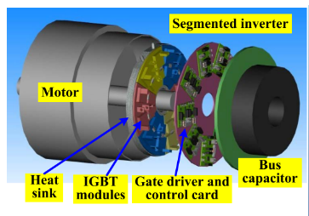
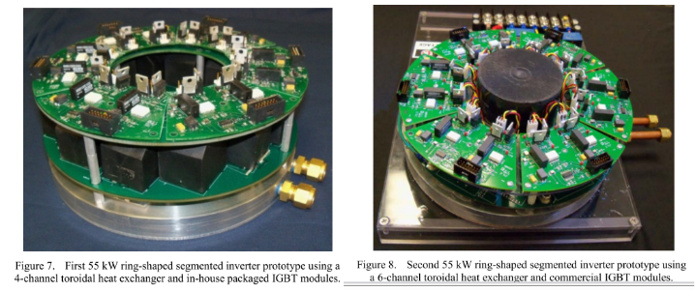
State of the Art
2013, An Inverter Packaging Scheme for an Integrated Segmented Traction Drive System
Gui-Jia Su, Lixin Tang, Curt Ayers, and Randy Wiles
55kW prototype (2 designs)
Doughnut shaped capacitors such as the Power Ring Film Capacitors
Second prototype: 17.8 kW/l and specific power of 15.6 kW/kg
The battery rms ripple current is reduced from 6.53Arms to 0.9Arms, an 86% reduction. (Motor load)

Slide 12
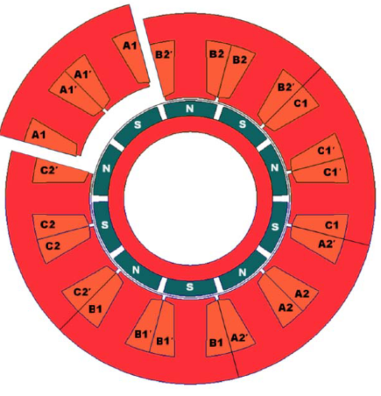
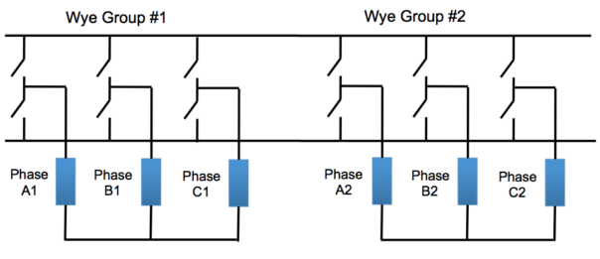
State of the Art
2014, Hardware Integration for an Integrated Modular Motor Drive Including Distributed Control
Adam Shea (Master Thesis), T.M. Jahns
First IMMD prototype unit that included a dedicated controller in each module
18kW (peak), 6-phase IMMD demonstrator unit for a traction drive
Half-bridge inverter for each phase with two discrete 600V IGBTs (20kHz)
The nominal dc bus voltage is 325 Vdc.
10kW six-phase fractional-slot concentrated winding PMSM (12/10).

Slide 13
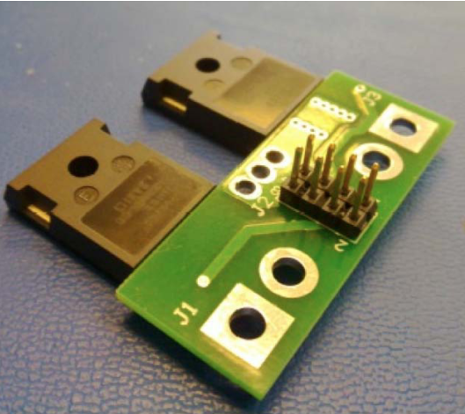
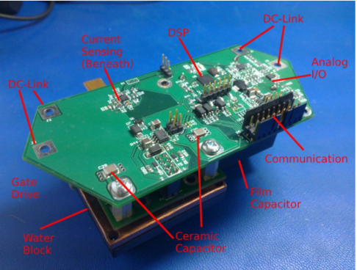
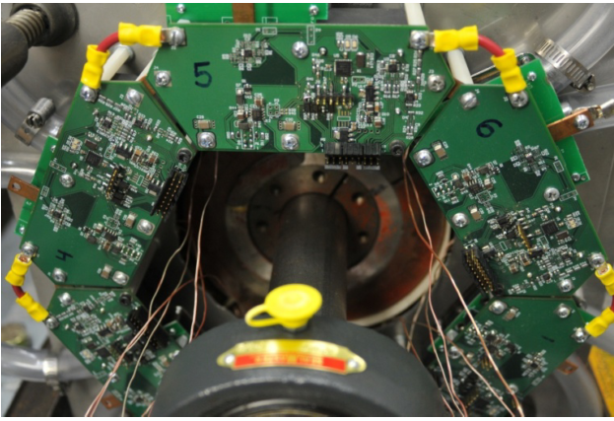
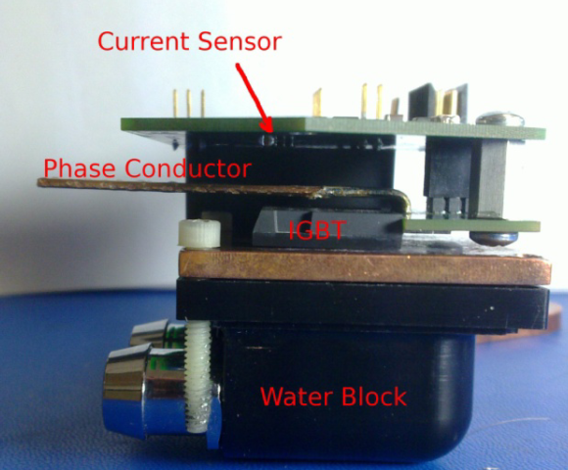
State of the Art
2014, Hardware Integration for an Integrated Modular Motor Drive Including Distributed Control
Adam Shea (Master Thesis), T.M. Jahns

Slide 14
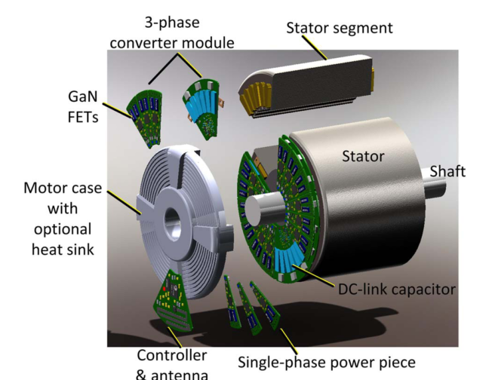
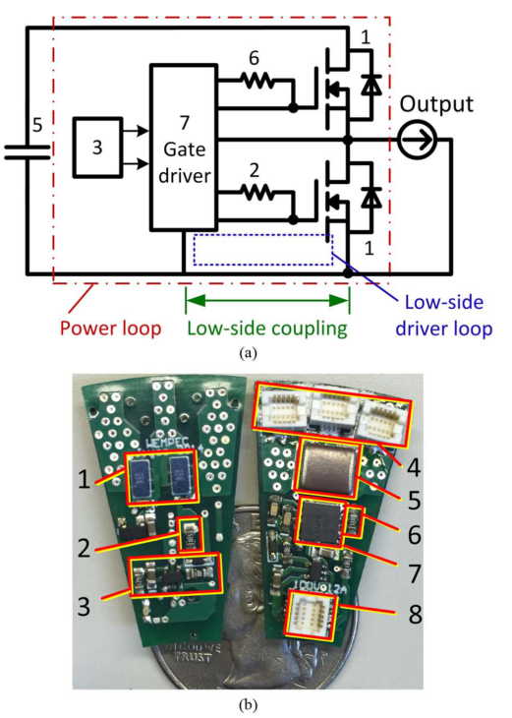
State of the Art
2015, Integrated modular motor drive design with GaN power FETs
Jiyao Wang (PhD Thesis), Ye Li, and Yehui Han
200V EPC GaN FETs, series connected topology, two modules interleaving
36-slot two-pole induction motor reconfigured to six leads
Experiment: Vdc = 200V, n = 2, fsw = 100kHz, Vline = 190V, Iline = 5A

Slide 15
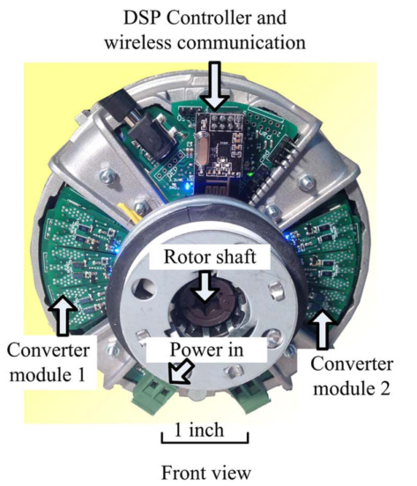
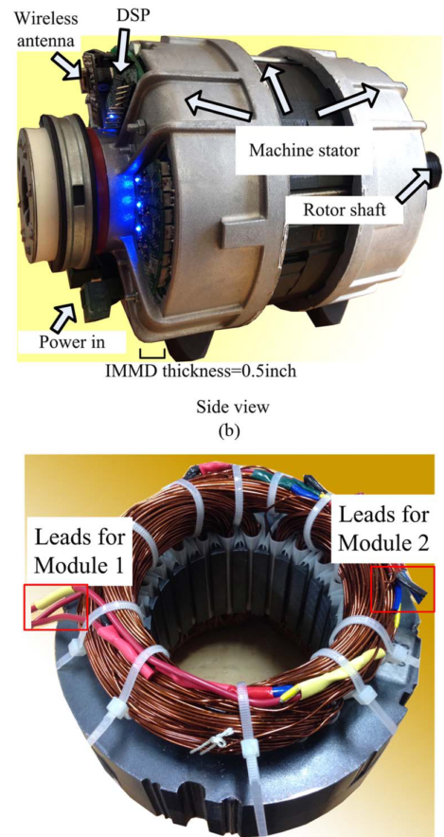
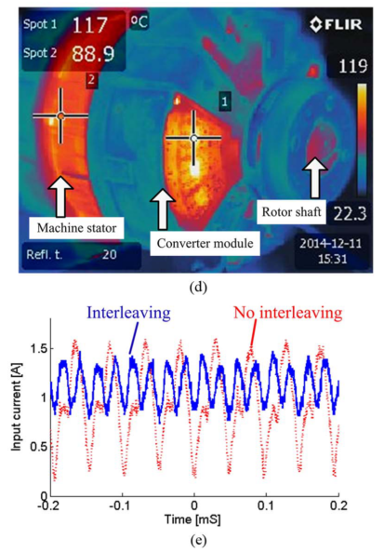
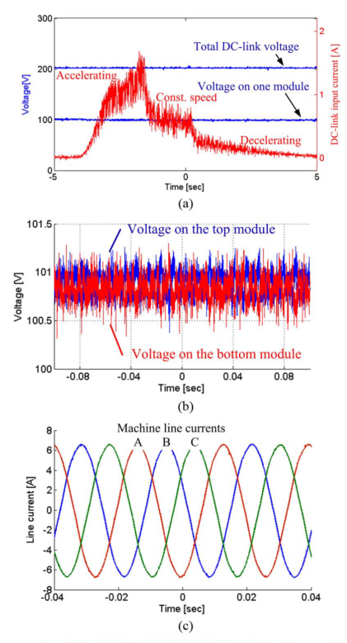
State of the Art
2015, Integrated modular motor drive design with GaN power FETs
Jiyao Wang (PhD Thesis), Ye Li, and Yehui Han

Slide 16
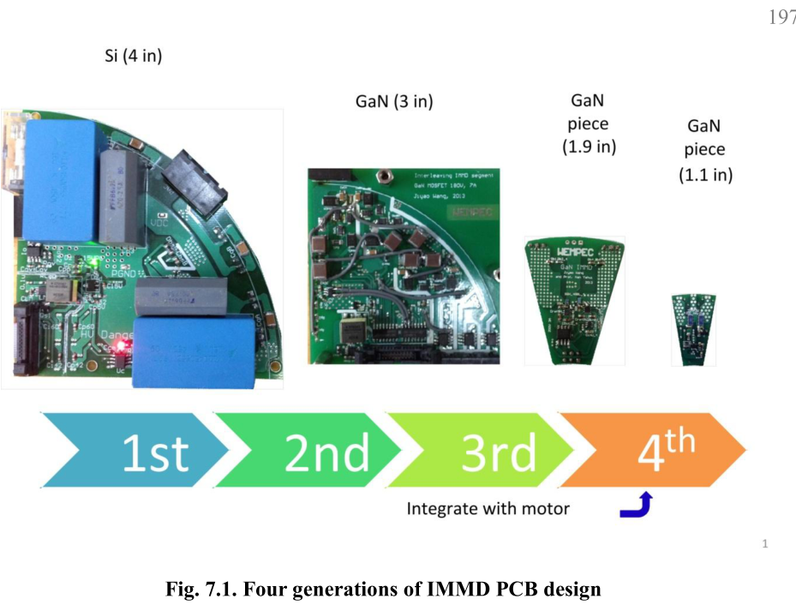
State of the Art
2015, Integrated modular motor drive design with GaN power FETs
Jiyao Wang (PhD Thesis), Ye Li, and Yehui Han
The first generation: The three phase converter module, Si devices, 10 kHz
The second generation: Three phase module design, GaN devices, 50 kHz.
The third generation: A single phase converter piece. GaN devices
The fourth generation: GaN devices, 100 kHz. The overall height 1/4 inch.

Slide 17
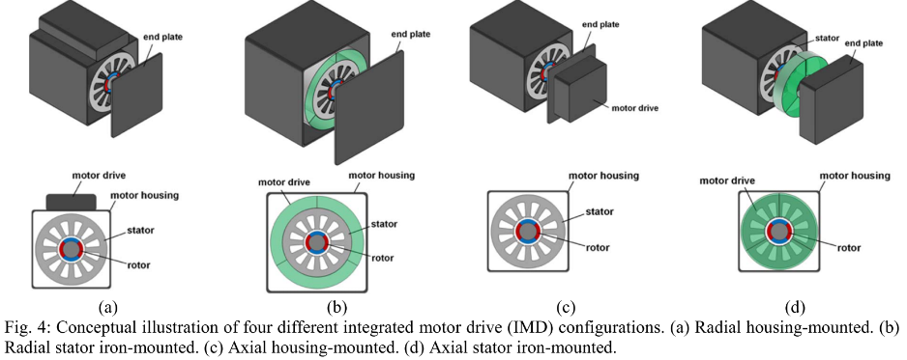
State of the Art
2017, Achieving High-Performance Electrified Actuation System with Integrated Motor Drive and Wide Bandgap Power Electronics
Woongkul Lee, Di Han, Silong Li, Bulent Sarlioglu, Tatiana A. Minav, Matti Pietola
IMD improves power density with 10-20% less volume and reduces 30-40% of the overall system costs of installation and manufacturing.

Slide 18
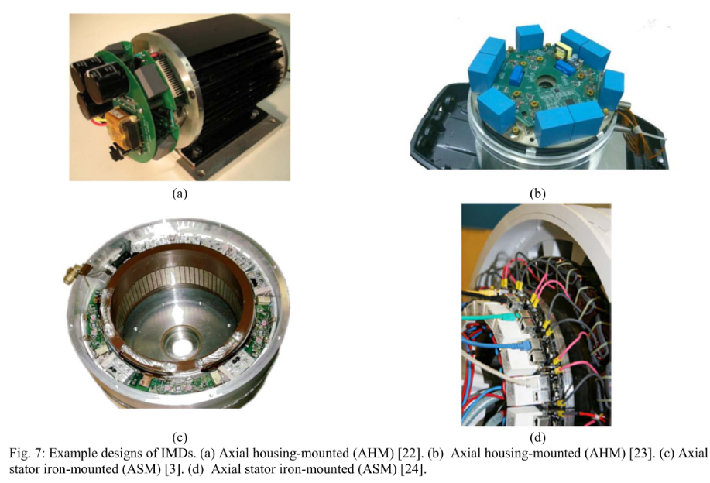
State of the Art
2017, Achieving High-Performance Electrified Actuation System with Integrated Motor Drive and Wide Bandgap Power Electronics
Woongkul Lee, Di Han, Silong Li, Bulent Sarlioglu, Tatiana A. Minav, Matti Pietola

Slide 19
Research Opportunities
New generation Wide Band Gap Power Semiconductor Devices: GaN FETs
Layout design, parasitics component modeling and minimization
Size reduction, passive component design and optimization
Modular motor drive topologies, fault tolerance, interleaving
Fault tolerant electrical machines, split winding machines
Vibration effects and minimization
Thermal design and analysis
Filter design with planar magnetics

Slide 20
Funded Projects
METU – BAP
Name: Gan Tabanlı Bir Tümleşik Modüler Motor Sürücü (IMMD) Tasarımı ve Geliştirilmesi
Number: BAP-03-01-2017-004
Budget: 18,500.00 TL
TÜBİTAK - ARDEB 3501
Name: 7.5 kW Sabit Mıknatıslı Tümleşik Modüler Motor Sürücü Sistemi Geliştirilmesi
Number: 117E252
Budget: 151,423.00 TL

Slide 21
What we have done so far

Slide 22
Prototype design

Slide 23
Future work

Slide 24
References

Slide 25

Thank you !
Mesut Uğur
mesut.ugur@metu.edu.tr
Department of Electrical and Electronics Engineering
Middle East Technical University
power.eee.metu.edu.tr

